Slide 1
Social Media Influencers
Faria Tasnim
Jose Acosta
Masrour Naderi
Sejal Bhatnagar
Srusti Rajeshbhai Gajjar
Suraj Suresh
Group 04

Slide 2
Who are social media influencers?
Understanding social media influencer data in analytics!
What do social media influencers do?
Overview of each social media platform
How can analytics help marketers?

Slide 3
Data Preprocessing

Slide 4
Overview of the Dataset
Dataset contains 4 snapshots (March, June, September, and October) for the Top 1000 accounts from Instagram based on follower count and from YouTube based on subscriber count, among all the variables some of the important are the following:
Influencer’s name/handle
Number of followers/subscribers
Audience Country – Name of the country in which the influencer has the greatest number of followers
Category designation for each account/channel
Data source:
https://www.kaggle.com/datasets/ramjasmaurya/top-1000-social-media-channels?select=social+media+influencers+-+Instagram+in+oct.csv
Dataset Cleaning Process
Standardized column headers across all files
Created a snapshot month for each file to identify the corresponding month
Combined each of the Instagram and YouTube files by vertically stacking
Datatype for continuous variables exported as text, converted values to numeric
Created “Ranking” label to order the top 1000 accounts for each month
Reduced dataset to the top 250 accounts for each month
Identified and populated various accounts with NULL values for Category and Audience Country
Combined like categories to reduce the number of account / channel category types

Slide 5
What are the top 5 countries represented in the top 250 accounts/channels for Instagram and YouTube? Any changes over time?
Objectives
What account/channel categories are represented in the top 5 countries?
What is the average authentic engagement across the top 5 countries?
What is the engagement rate for the top 5 countries across the categories represented?
Of the top 10 accounts, what is the follower distribution and category makeup?
What is the average authentic engagement for the top 10 accounts/channels?
Does a higher engagement rate lead to higher account/channel growth rates?

Slide 6
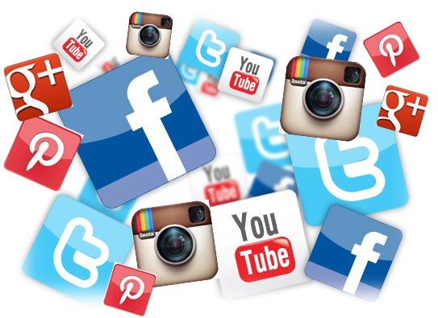
What are the top 5 countries represented in the top 250 accounts/channels for Instagram and YouTube? Any changes over time?

Slide 7
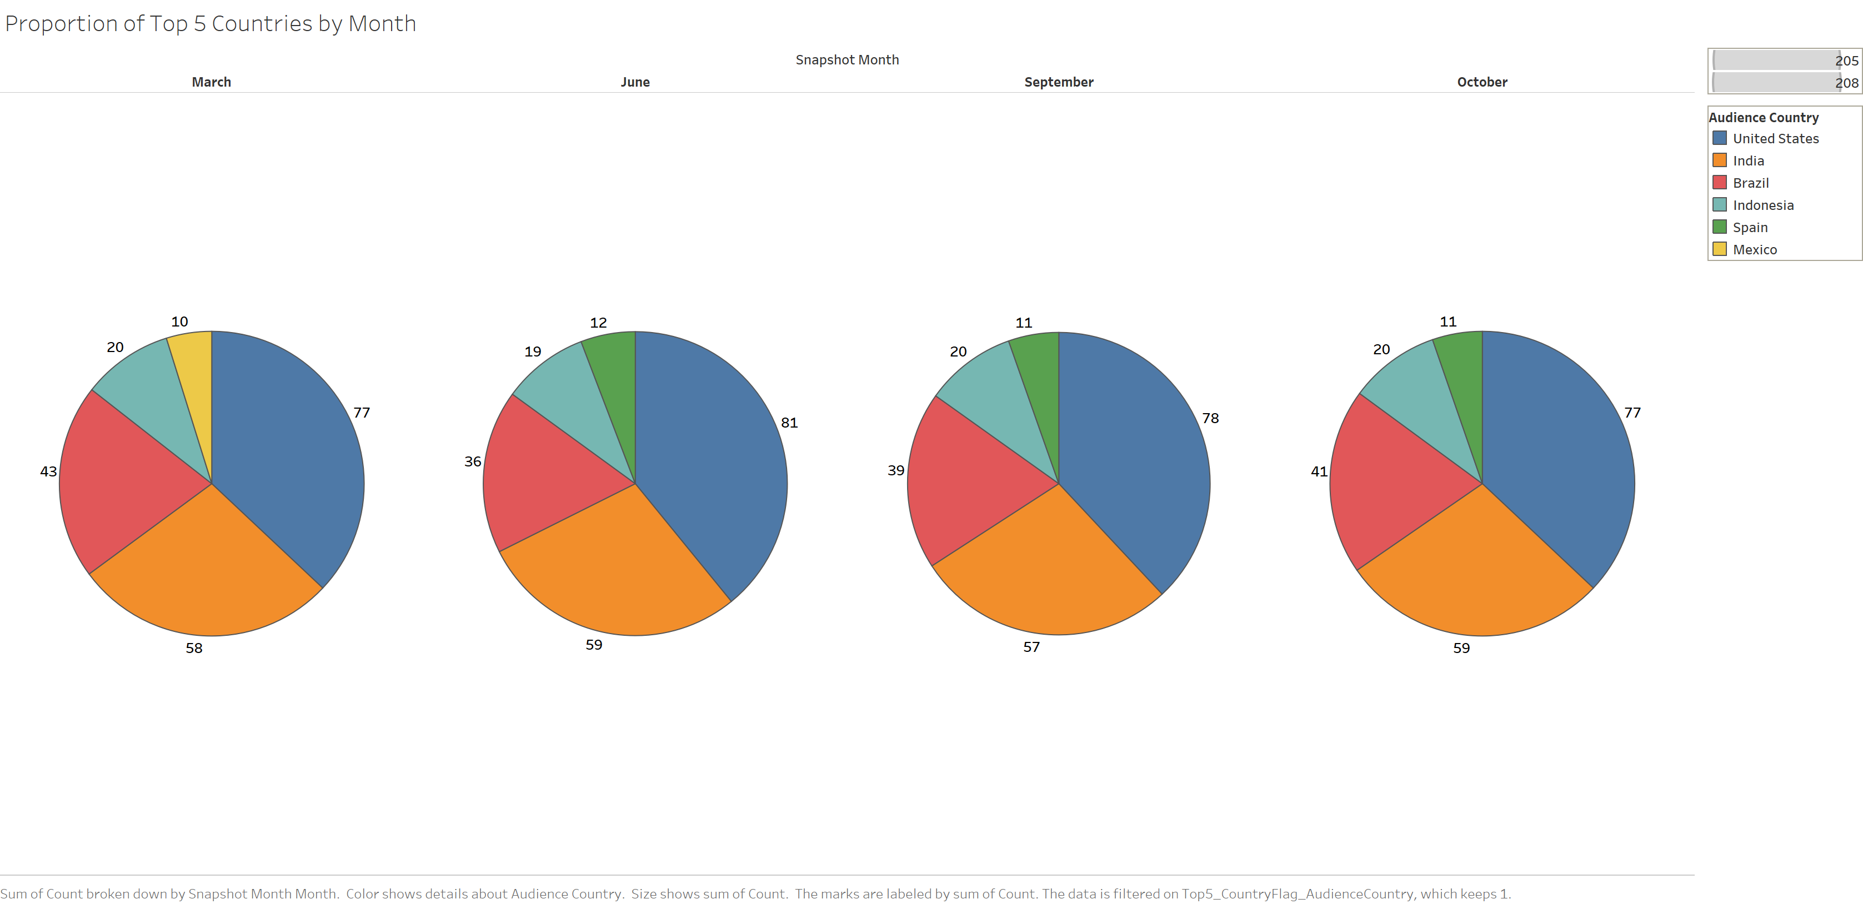
Which Countries make up top Accounts?
Instagram
Top 5 countries and their proportions remained consistent across all 4 months.
Mexico fell off after the first month and was replaced by Spain.

Slide 8
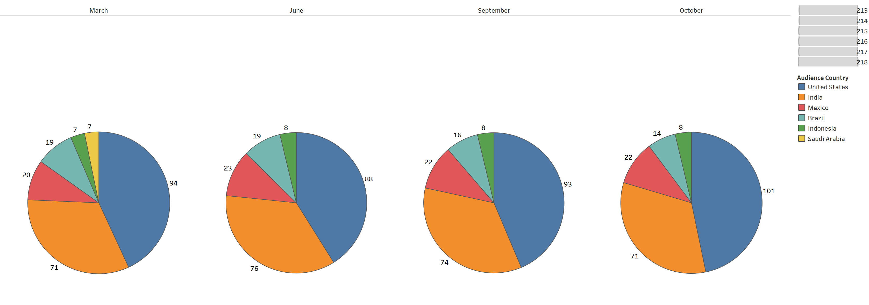
Which Countries make up top Channels?
YouTube
Top 5 countries remained consistent across the 4 months.
Overall proportions remained similar as well, the US saw a drop from March to June and increased in the 2 subsequent months.

Slide 9
What account/channel categories are represented in the top 5 countries?

Slide 10
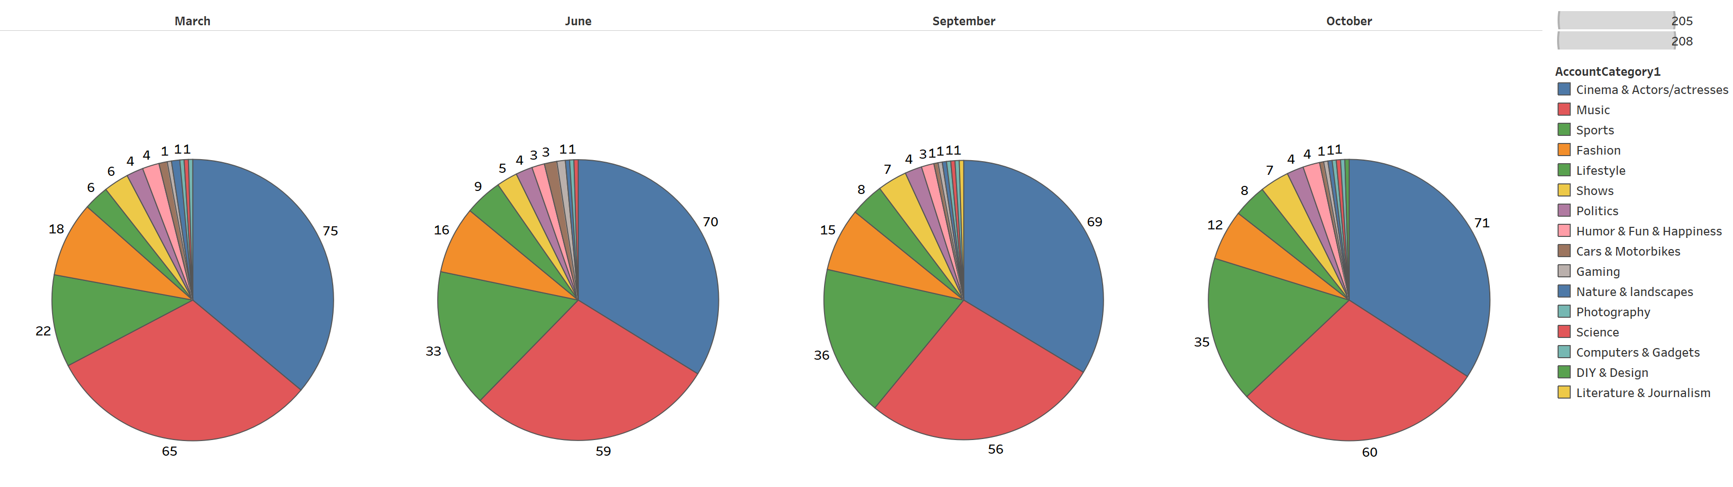
Which Categories have top Accounts?
Instagram
There are several account categories represented in the top 5 countries, but the list is dominated by 4 categories for Instagram: Cinema and actors, music, sports, and fashion.

Slide 11
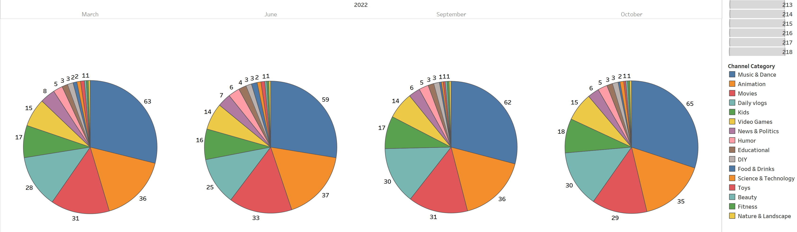
Which Categories have top Channels?
YouTube
Several account categories are represented in the top 5 countries, but the list is dominated by 6 categories for YouTube: Music and dance, animation, movies, daily vlogs, kids, and video games.

Slide 12
What is the average authentic engagement across the top 5 countries?

Slide 13
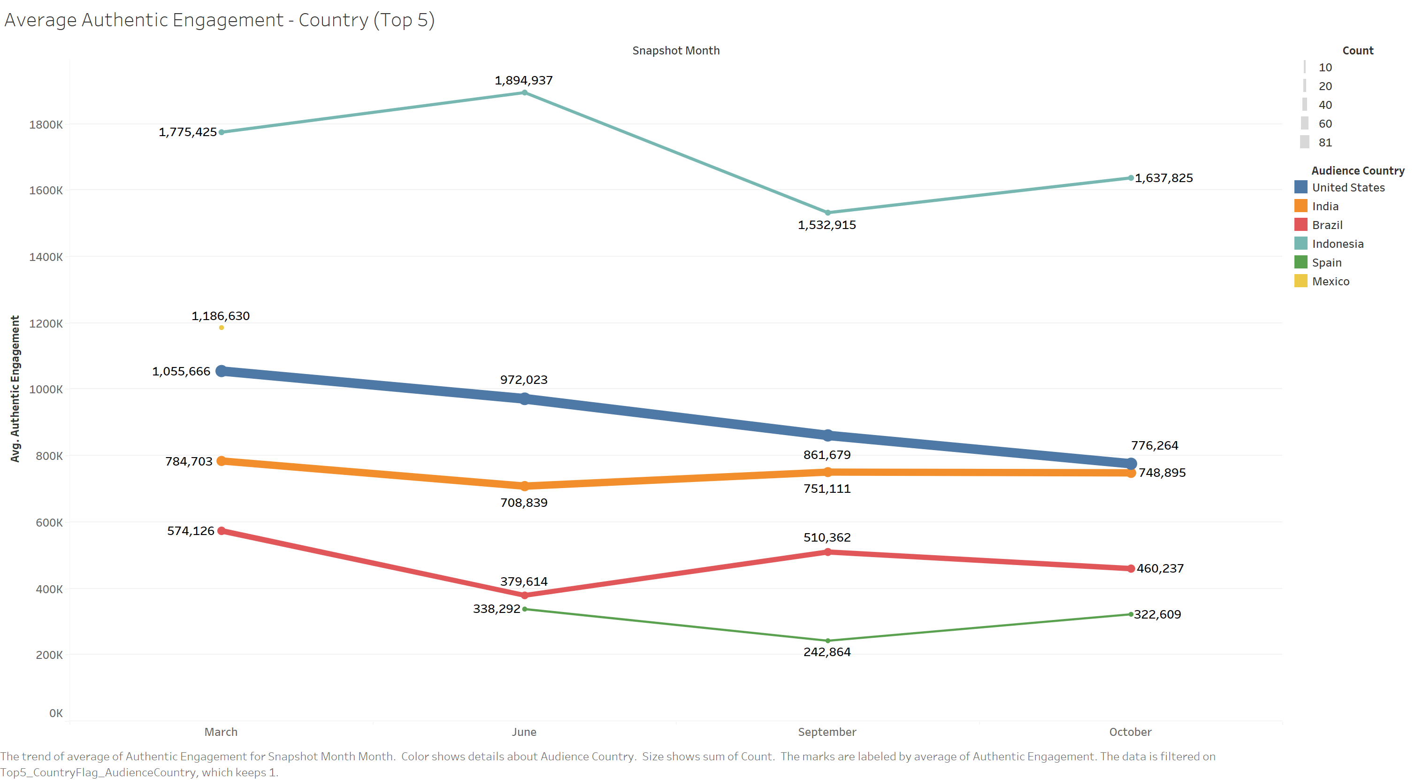
What is Average Authentic Engagement with respect to top Countries?
Instagram
Overall Indonesia has the highest average authentic engagement and Spain has the lowest.
Indonesia’s high average authentic engagement is driven by Music and Cinema accounts.
Although Indonesia has the highest average authentic engagement, the US and India make up most accounts represented – Can be observed by the line thickness.

Slide 14
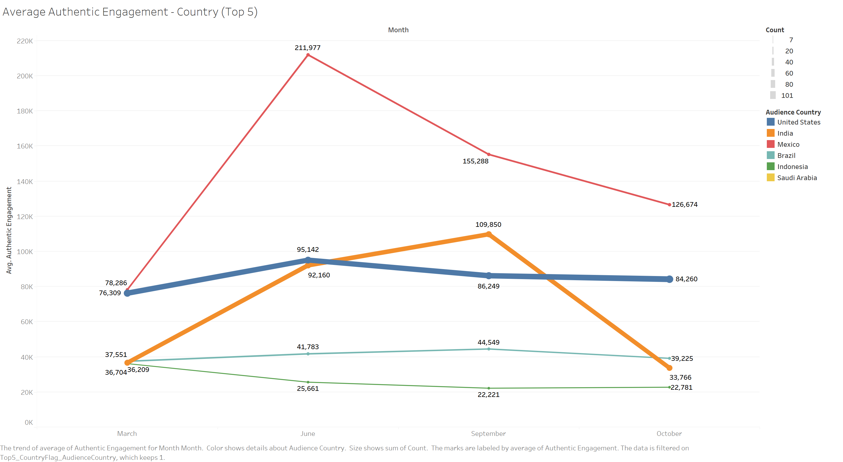
What is Average Authentic Engagement with respect to top Countries?
YouTube
Overall Mexico has the highest average authentic engagement and Indonesia has the lowest.
Unlike other countries the majority of Mexico’s representation is from Animation and Daily Vlogs.
Although, Mexico has the highest average authentic engagement, US and India make up most of the channels represented by – Can be observed by the line thickness.

Slide 15
What is the engagement rate for the top 5 countries across the categories represented?

Slide 16
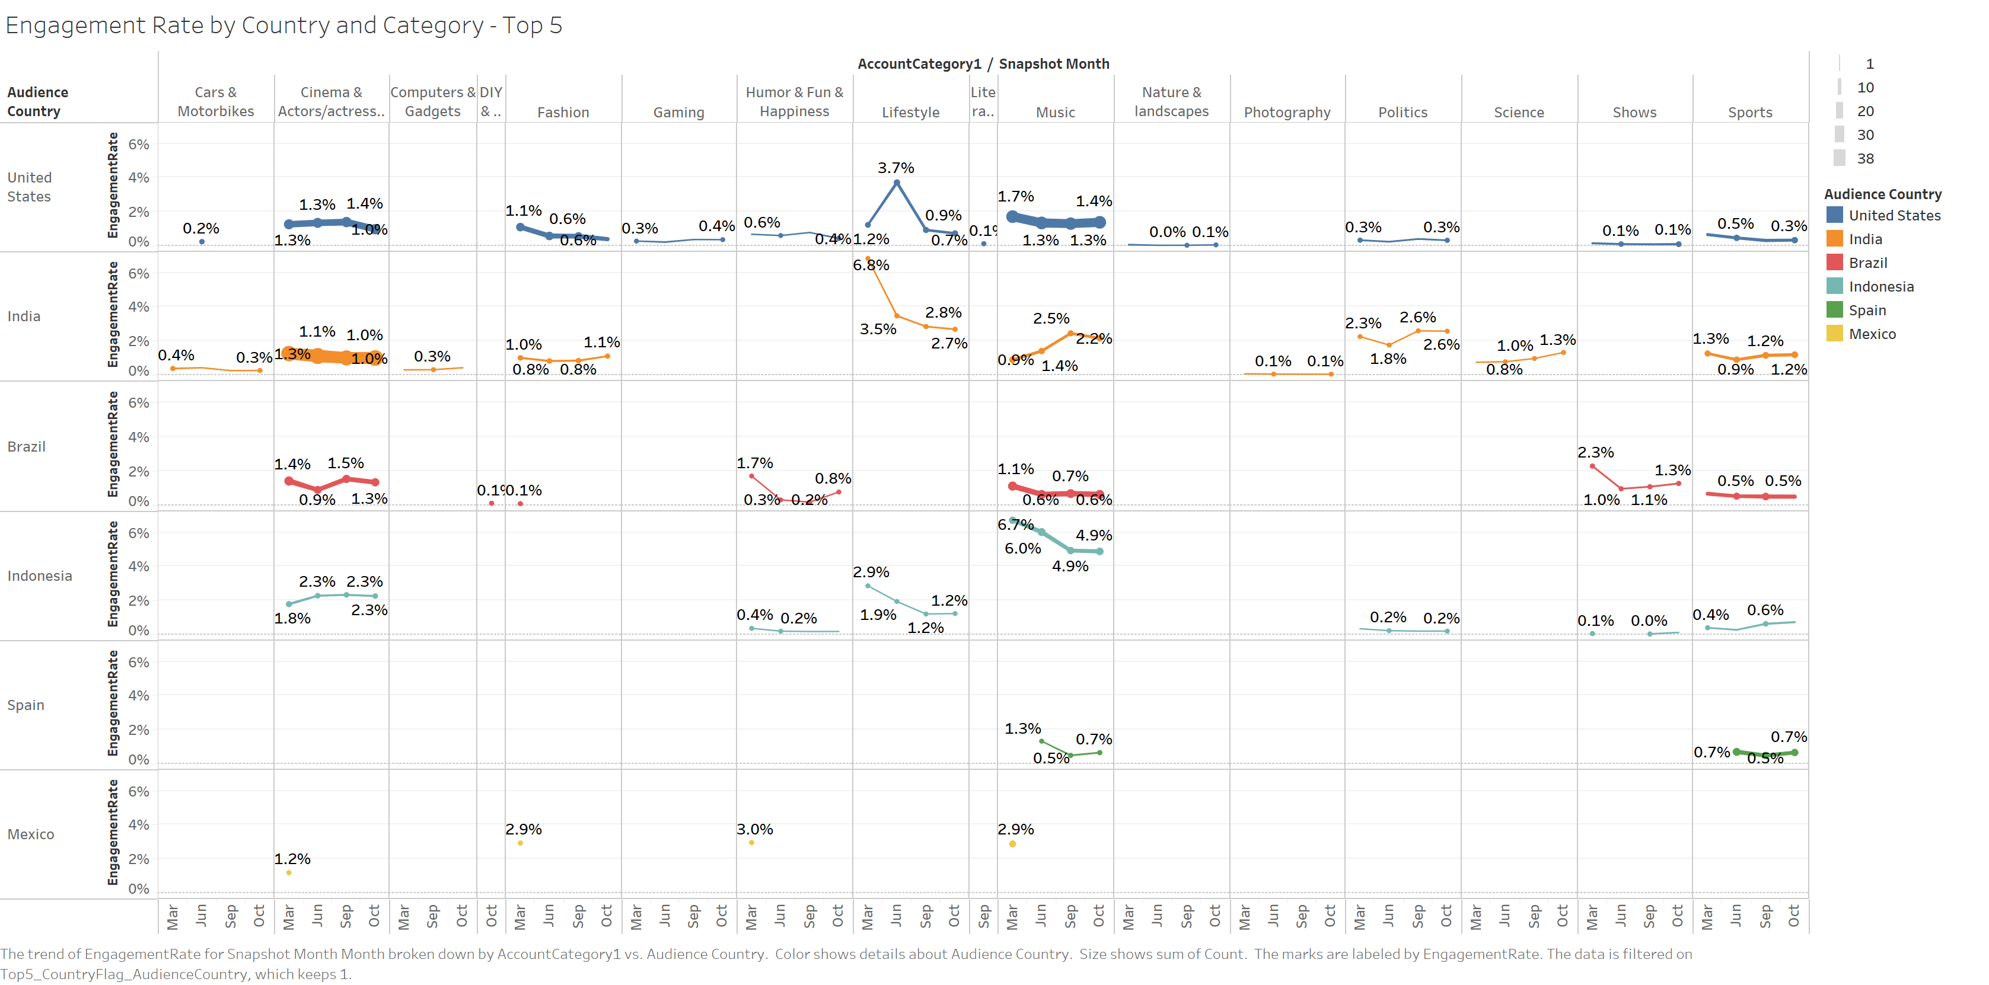
What is the Engagement Rate for the top Countries?
US cinema & actors, US Music, and Indian cinema have the highest representation. These categories have consistent engagement rates month over month.
Instagram

Slide 17
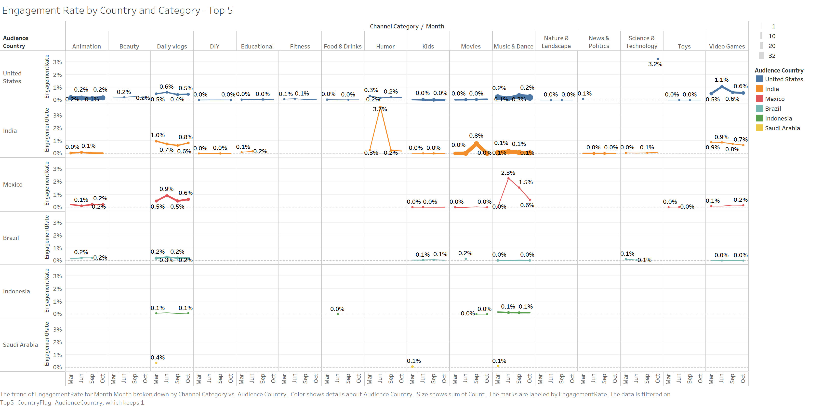
What is the Engagement Rate for the top Countries?
US animation, music and dance, Video games, and Indian movies and Music and dance have the highest representation. These categories all have consistent engagement rates month over month.
There is more movement in the engagement rate for less represented categories, this is likely since one channel can have a greater impact on the overall engagement rate for less represented categories.
YouTube

Slide 18
Of the top 10 accounts/channels, what is the follower distribution and category makeup?

Slide 19
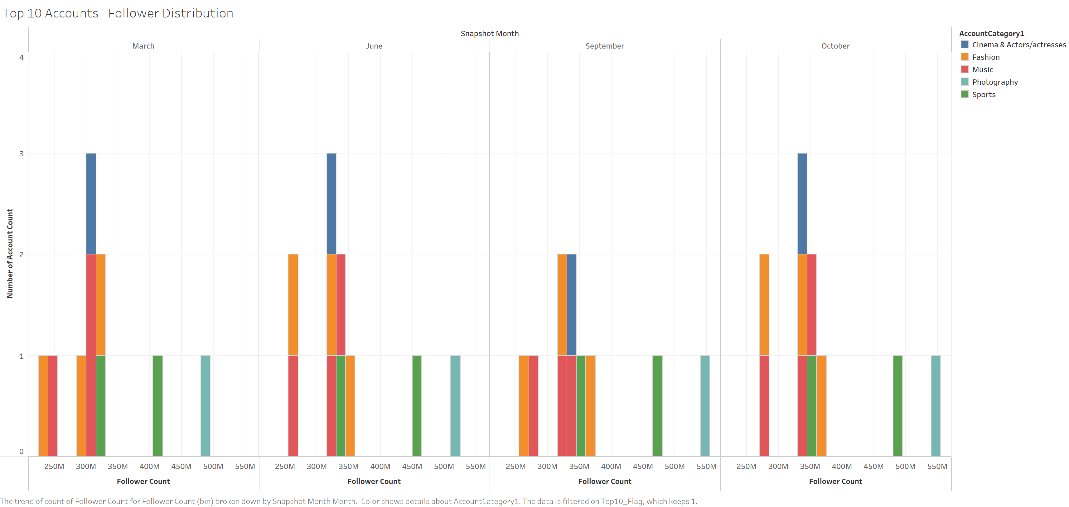
How is the Distribution of the Followers in top Accounts?
Instagram
Tightly packed cluster with around 300 million subscribers across all months, each month has 2 outliers that range from 400 to 550 million followers.

Slide 20
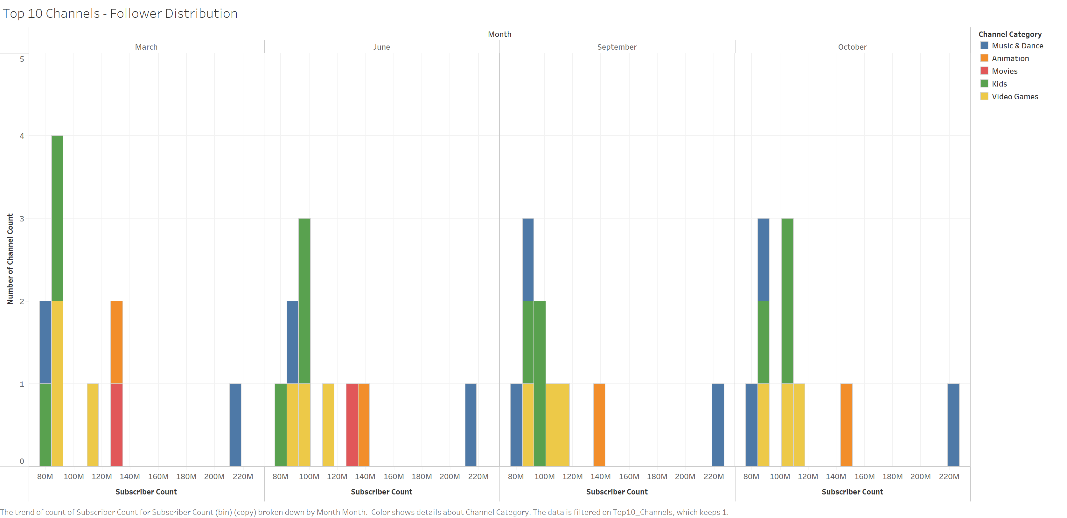
How is the Distribution of the Followers in top Channels?
March and October’s distribution is spread out, while June’s and September’s distribution is tightly packed. All months have an outlier with over 200 million subscribers.
YouTube

Slide 21
What is the average authentic engagement for the top 10 accounts/channels?

Slide 22
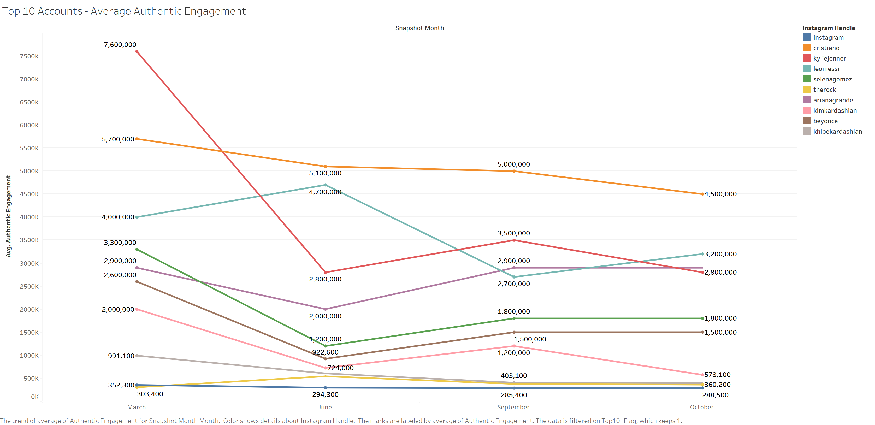
What is Average Authentic Engagement with respect to top Influencers?
7 of the top 10 accounts have an average authentic engagement for each month that is higher than the overall average authentic engagement of 1 million for the 4 months of observation.
Kylie Jenner saw a big reduction in average authentic engagement after March.
Most of the accounts saw a dip in the average authentic engagement rate except for Leo Messi.
Instagram

Slide 23
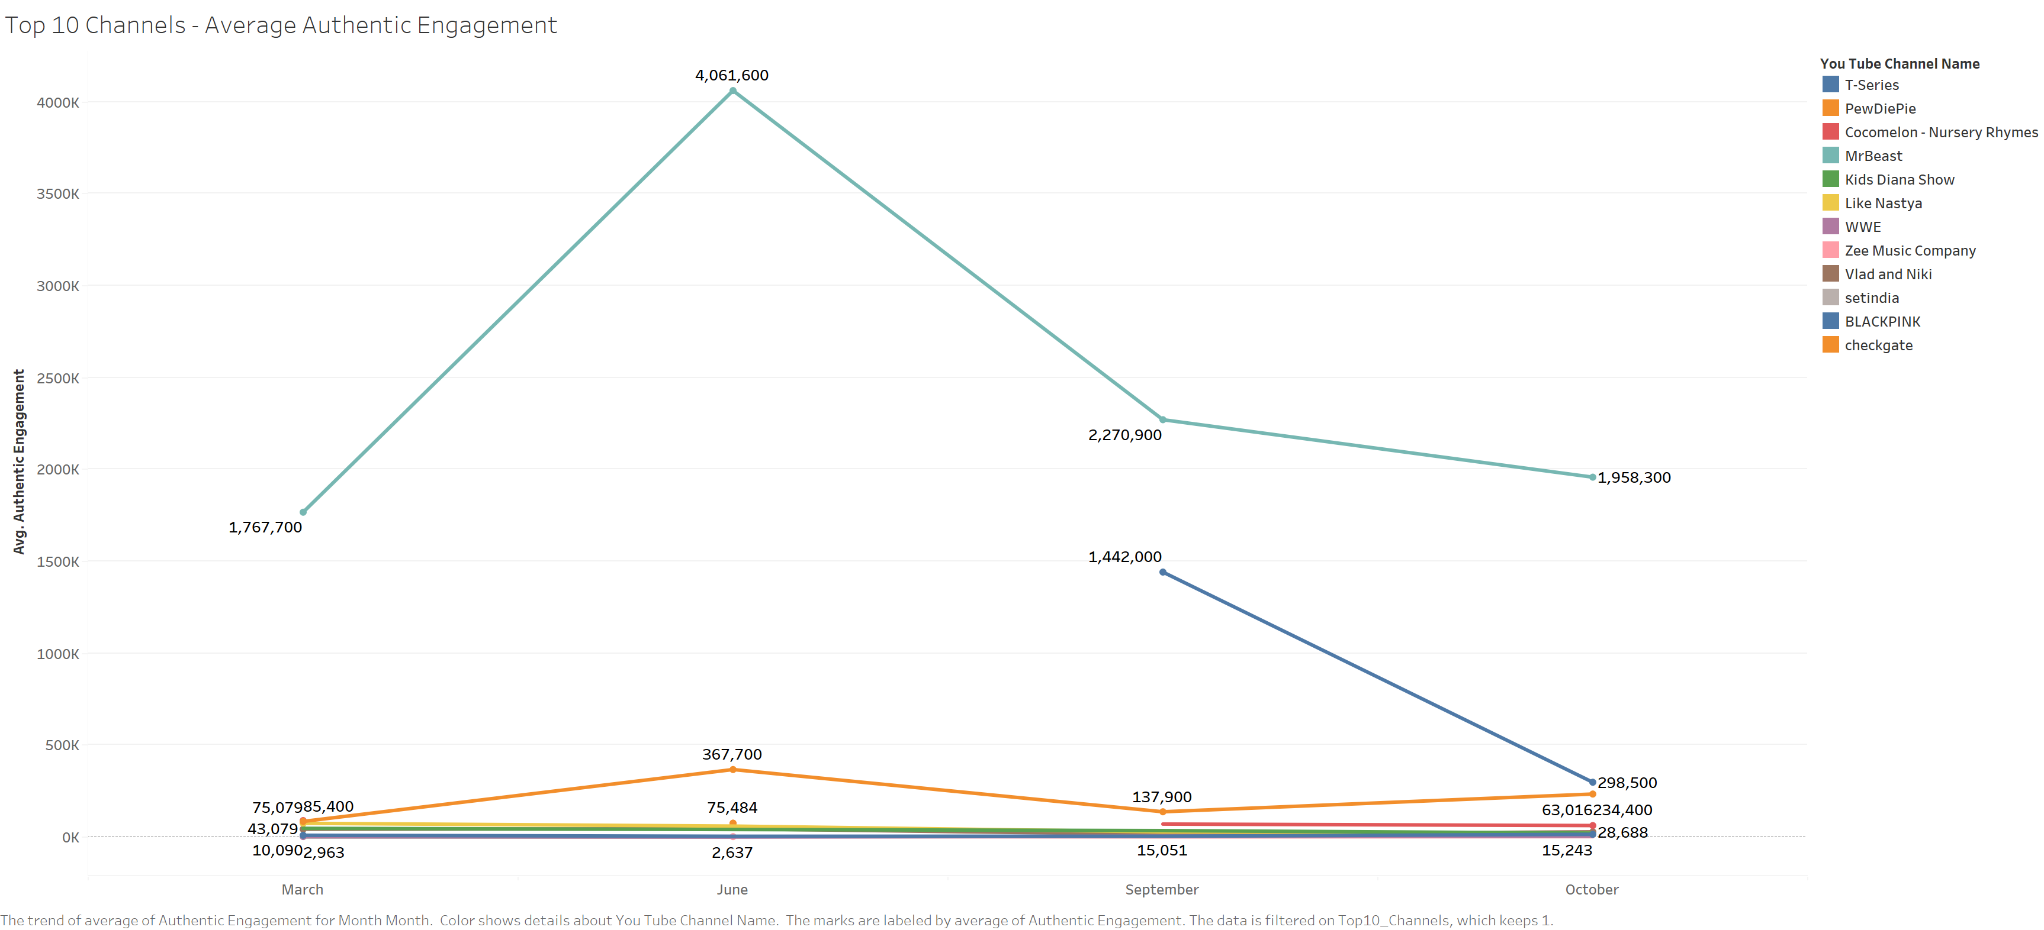
What is Average Authentic Engagement with respect to top Channels?
Most of the top 10 channels are within the overall average authentic engagement of around 86k for the 4 months of observation.
There are a few outliers in Mr. Beast, PewDiePie, and BLACKPINK channel.
YouTube

Slide 24
Does a higher engagement rate lead to higher account growth rates?

Slide 25
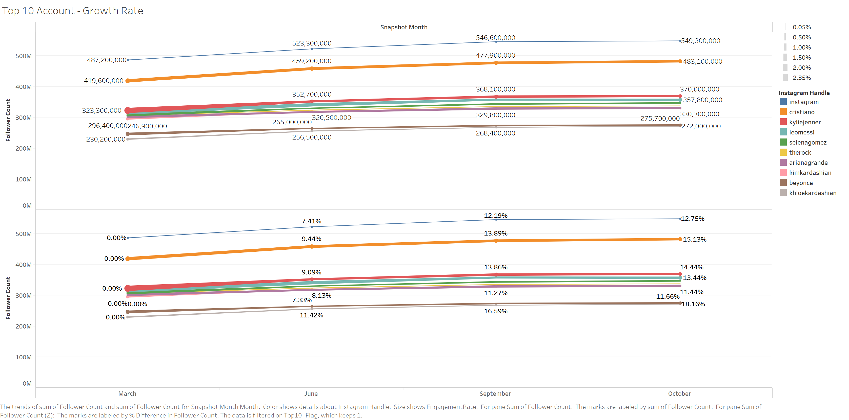
What is the Growth Rate of top influencers?
The cluster of accounts with around 300M followers all have similar growth rates over the same period and these accounts belong to celebrities in cinema, music, sports, and fashion.
Instagram

Slide 26
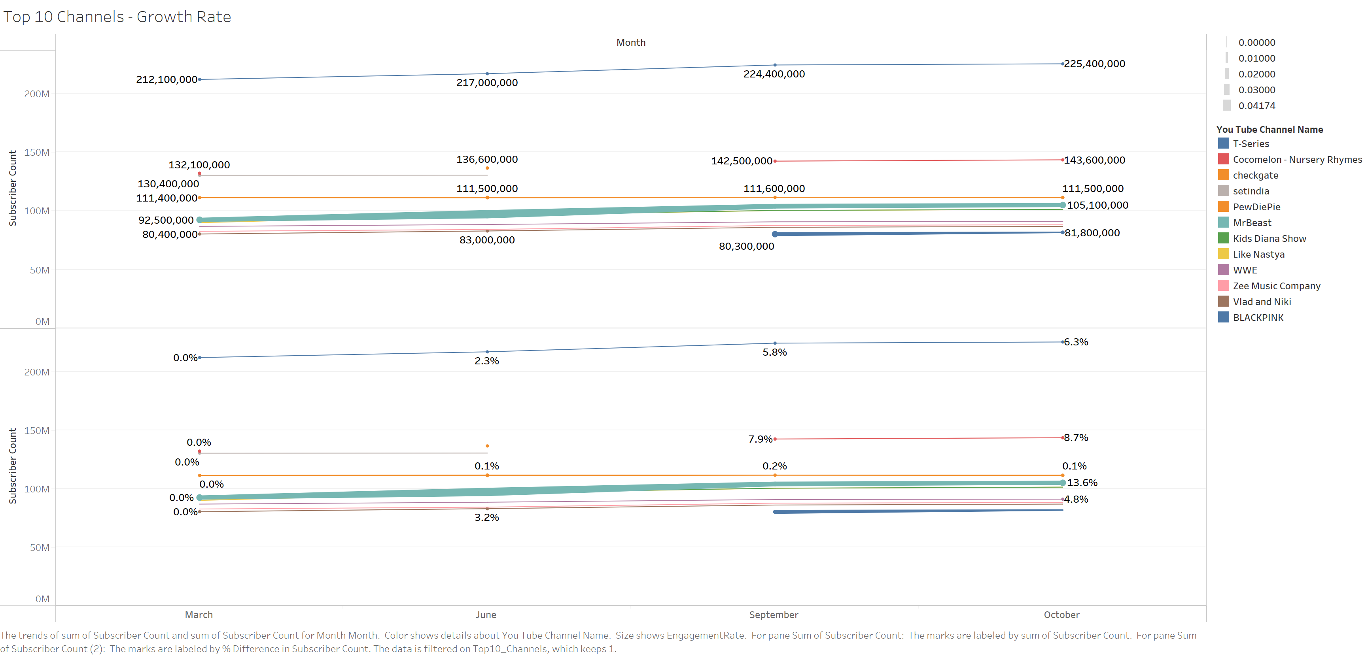
What is the Growth Rate of top channels?
YouTube
Mr. Beast’s channel saw the highest growth rate in comparison to the other top 10 channels. This channel also has the highest average authentic engagement rate, and there seems to be a positive correlation between engagement rate and growth rate.

Slide 27
Main Observations
1.
2.
3.
Across both platforms, the top countries represented in the top 250 accounts and categories are consistent.
A positive correlation between authentic engagement and engagement rate leads to a positive growth rate.
Teaming up with accounts that have higher growth rates can lead to higher success rates for companies.

Slide 28
Recommendation
How do you use this information?
How can these findings benefit companies?
What are the drawbacks of using social media for promotion or advertising tools?

Slide 29

Thank you!!!
Any Questions?

